Slide 1


Australian Football League Dashboard
Project 2 – Group 1

Slide 2
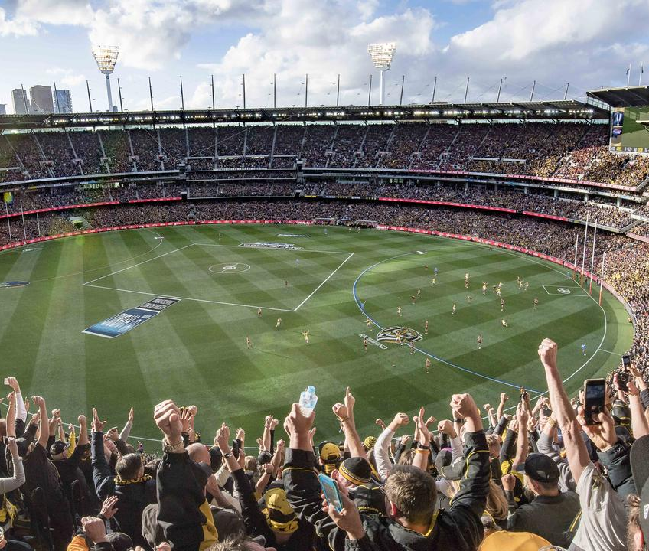

Data Munging Process
Required AFL data for this project was
extracted by requesting API calls.
We used Squiggle API to obtain the
data.
The Squiggle API offers public
access to raw data about AFL.

Slide 3
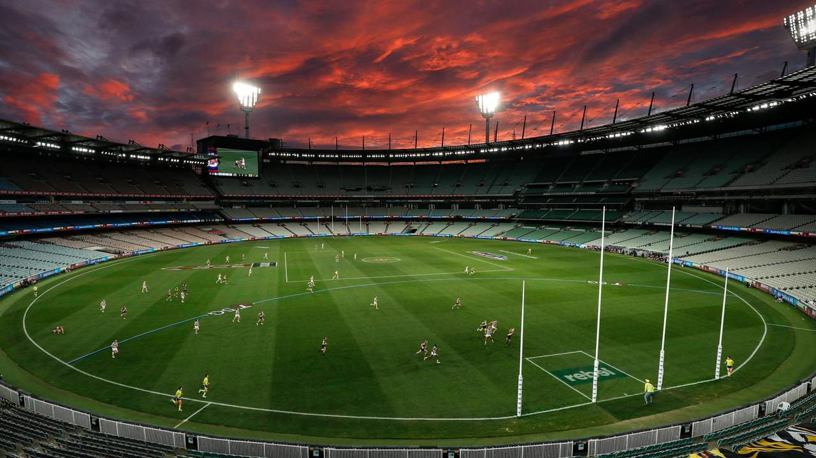

Coding Approach
Using Jupyter Notebook and pandas,
we cleaned and transformed the data according to our needs.
Based on structure of data frames,
PostgreSQL was our database of
choice.

Slide 4
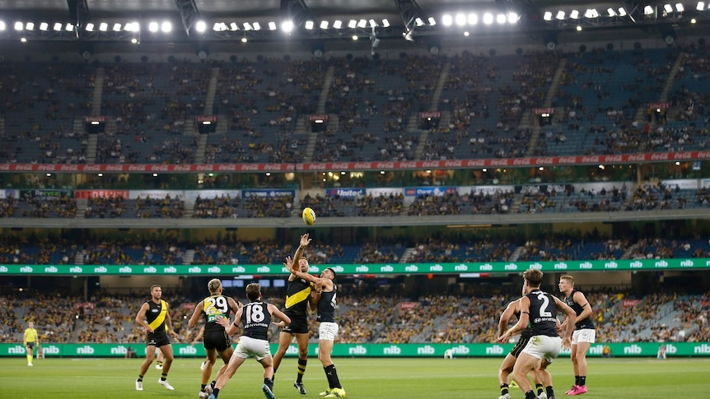

Databasing
We created out table schemas via Quick
DBD and created our PostgreSQL relational database.

Slide 5
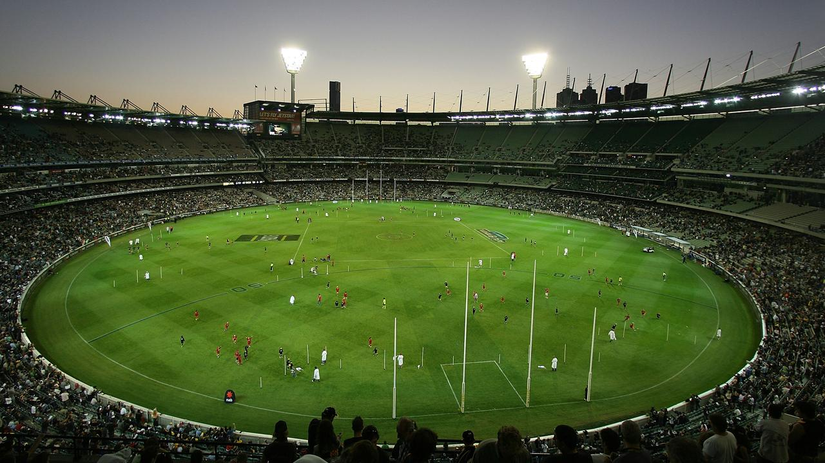

Data Visualisation
We used JavaScript libraries (D3 and AnyChart) to draw insightful AFL team performance visualisations.

Slide 6
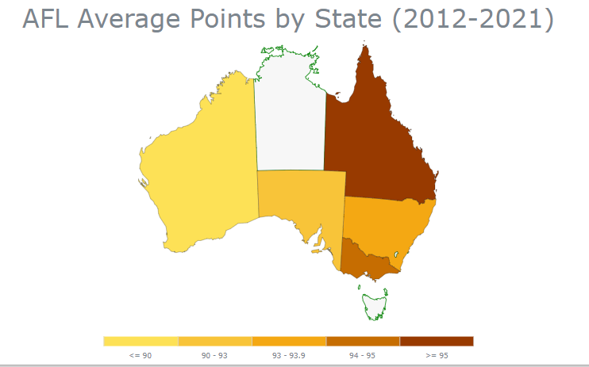
Historical average points overview by state

Slide 7
Heatmap - Ishaan

Slide 8
Scatter Plot

Slide 9
Diverged Stacked Bar Chart

Slide 10
Final Dashboard Look

Slide 11


